Slide 1
Wisconsin Lane Closure System (WisLCS)
Training

Slide 2
Introductions
Brian Sippel
Scott Kozlik
WisDOT - BTO
Work Zone Management
(414) 322-4185
Brian.sippel@dot.wi.gov
WisDOT - BTO
STOC
(414) 227-2161
Scott.kozlik@dot.wi.gov
Self-Introductions
Name, LCS experience and role

Slide 3
Introductions
Brian Sippel
Chris Quesnell
WisDOT - BTO
Work Zone Management
(414) 322-4185
brian.sippel@dot.wi.gov
Lakeside Engineers
BTO Consultant
(262) 789-8200
chris.quesnell@lakesideengineers.com
Self-Introductions
Name, LCS experience and role

Slide 4
Agenda
Background
Interfaces
Additional LCS Resources
Support Tools
Closure Walk-Through
Activity

Slide 5
Background
Overview, Roadways, Users, and Regions

Slide 6
Overview
WisLCS Description:
  BTO Sponsored Tool
  UW TOPS Lab developed system
    WisTransportal System
  Web-based
  Role-based
  Online repository to request, approve, and track lane closures on Interstate, US Highways, and State Highways

Slide 7
Overview
WisLCS Benefits:
  Facilitate the request, approval, and modifications of lane closure information
  Coordinate activities to reduce delays and potential conflicts
  Eliminate duplications and inefficiencies by streamlining information into one system
  Archive historical data for future use
  Facilitate data sharing

Slide 8
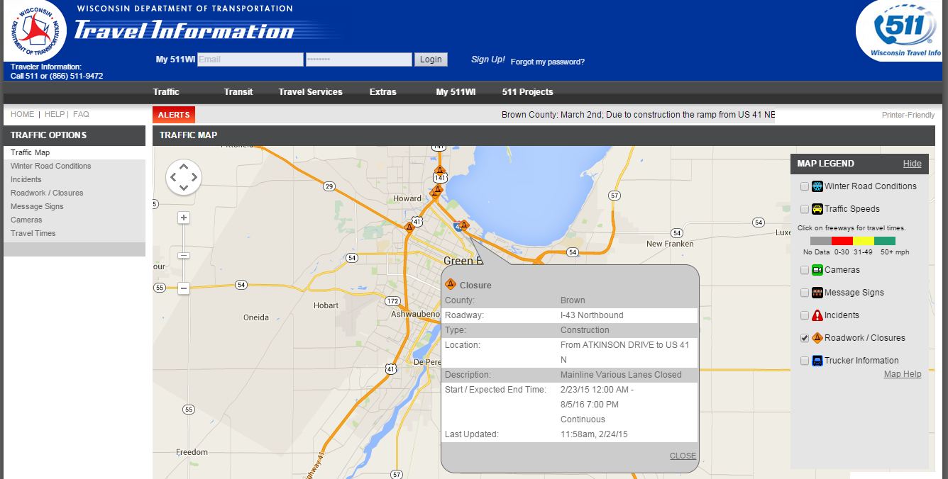
Overview
WisLCS Use Example:
Wisconsin 511 System http://www.511wi.gov or Dial 5-1-1

Slide 9
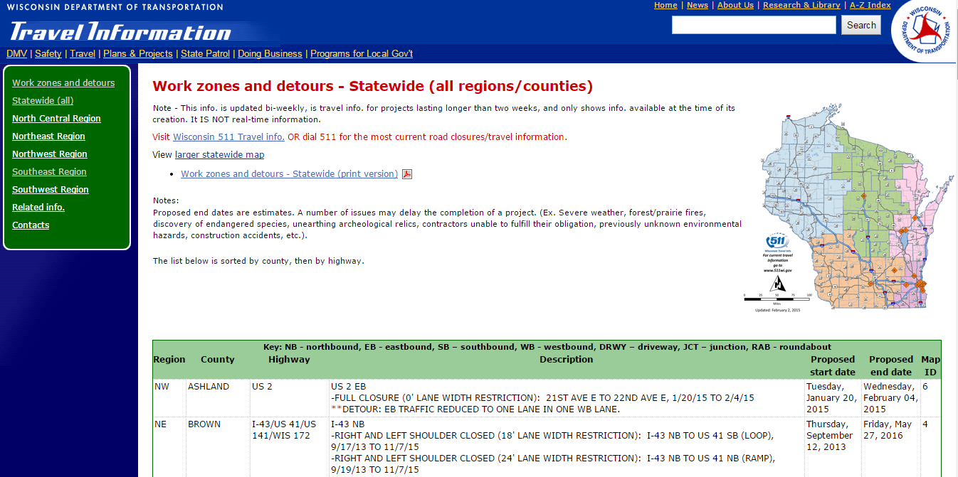
Overview
WisLCS Use Example:
WisDOT Website http://www.dot.wisconsin.gov/travel/road/workzones.htm

Slide 10
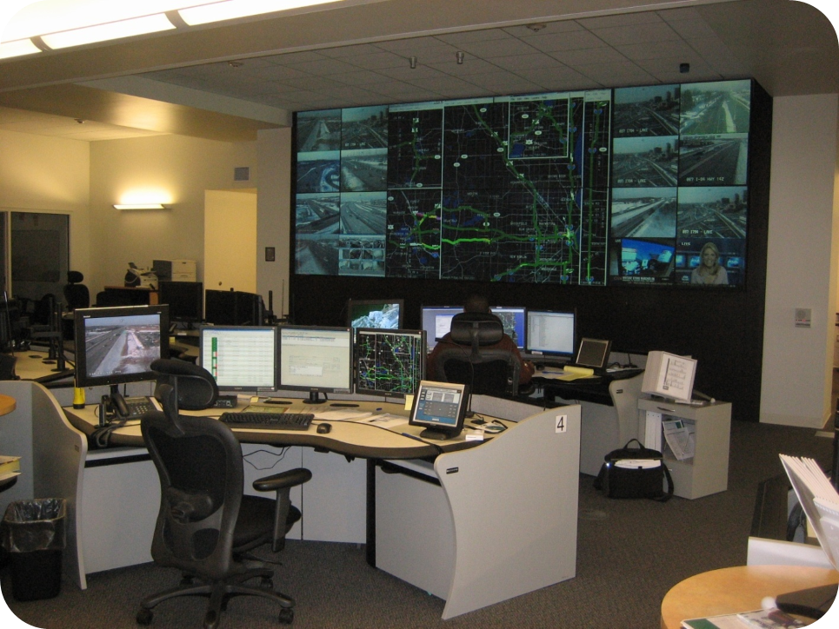
Overview
WisLCS Use Example:
Statewide Traffic Operations Center
STOC Operator Tasks:
DMS Signing
Contact info
Emergency closure entry
Assist project staff with cancellations

Slide 11
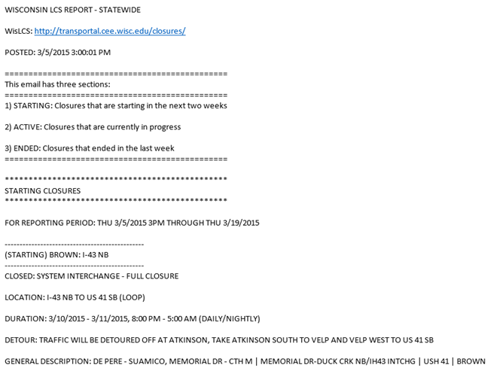
Overview
WisLCS Use Example:
Daily/Weekly E-mail Reports

Slide 12
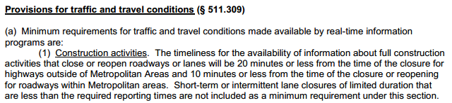
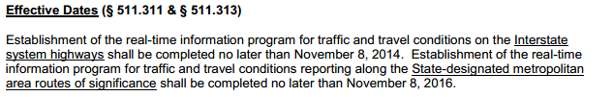
Overview
WisLCS Use Example:
FHWA Real-Time System Management Information Program (Section 1201)

Slide 13
Overview
WisLCS Use Example:
Third-Party Traffic Information
  Vehicle Navigation Systems
  Phone/Tablet Apps
  Websites
  Social Media
  News Reports

Slide 14
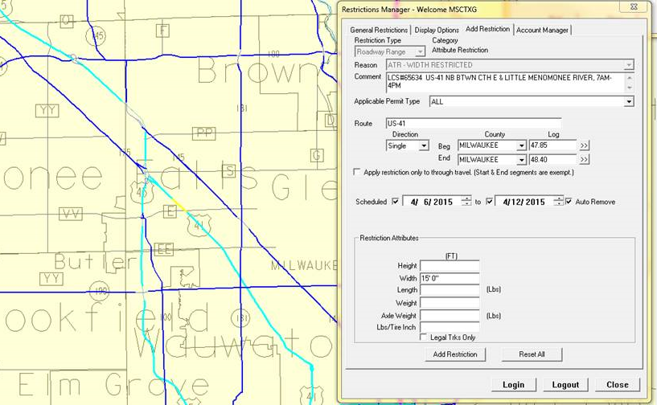
Overview
WisLCS Use Example:
Oversize/Overweight Permitting - Superload

Slide 15
Overview
What closures should be entered?
  All let projects
  Design projects (e.g. soil borings, inspections, etc…)
  Planned maintenance
  Planned permit/utility restrictions
  Major special events
  Unplanned emergency lane closures

Slide 16
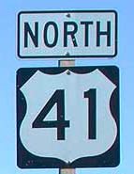
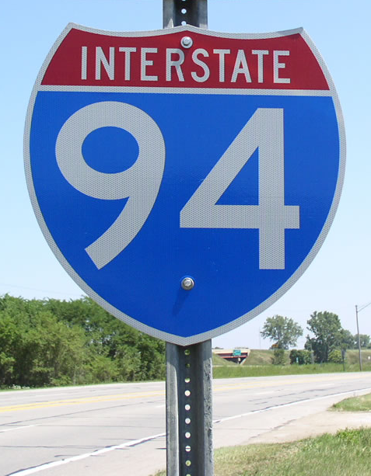
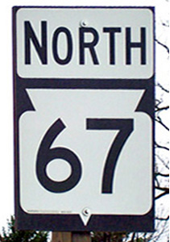
Overview
Which roadways is the LCS concerned with?
  Interstates
  US highways
  State highways

Slide 17
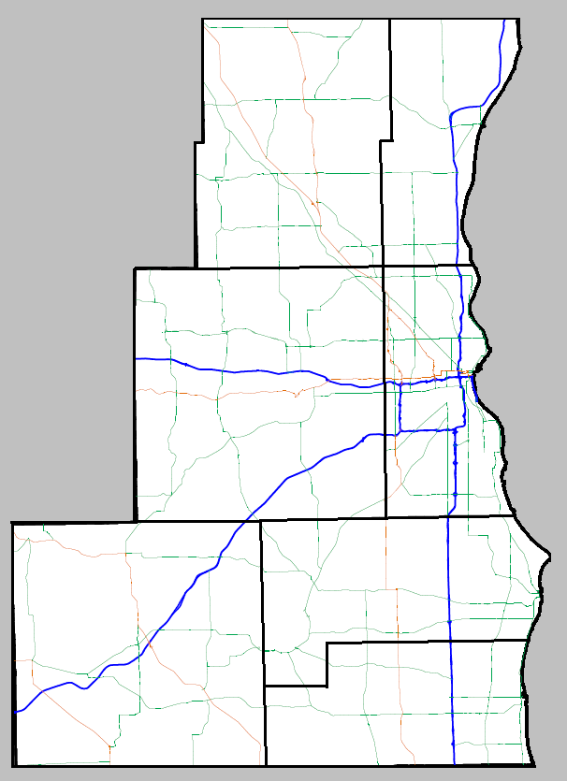
Priority Roadways
Southeast Region
I-43
I-94
I-894
US 12
US 41
I-794/WIS 794
US 45
WIS 16
WIS 119
WIS 145
WIS 341

Slide 18
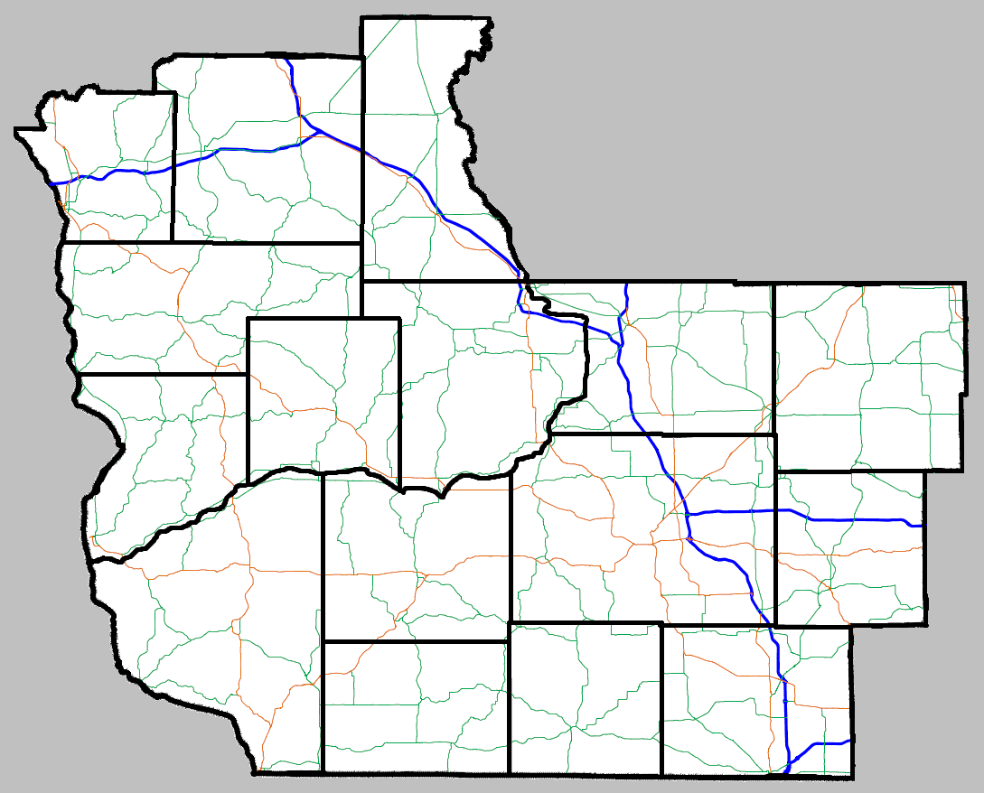
Priority Roadways
Southwest Region
I-39
I-43
I-90
I-94
US 12
US 14
US 41
US 51
US 53
US 151
WIS 26
WIS 30

Slide 19
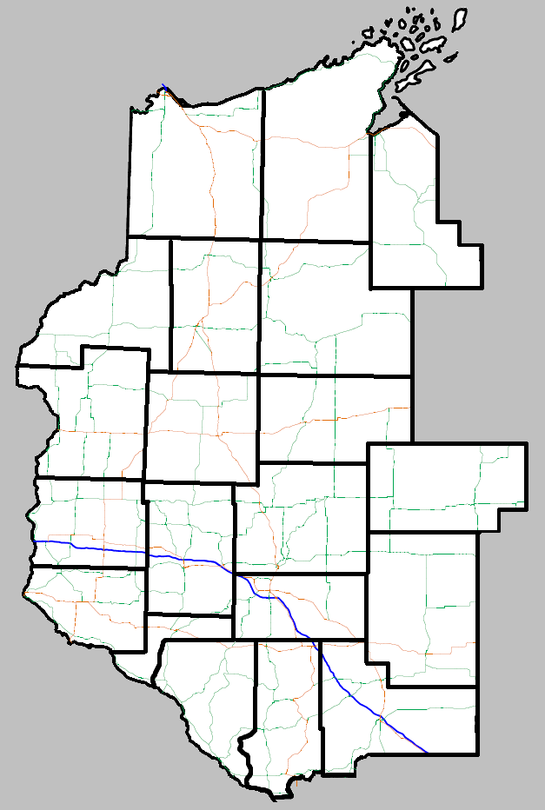
Priority Roadways
Northwest Region
I-94
I-535
US 53
WIS 29

Slide 20
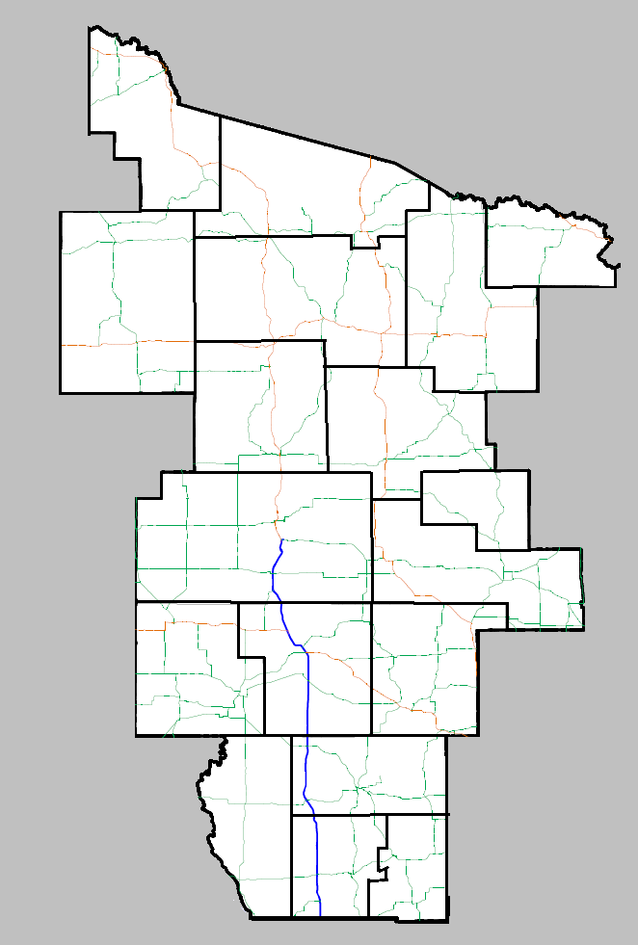
Priority Roadways
North Central Region
I-39
US 51
US 10
WIS 29

Slide 21
Priority Roadways
Northeast Region
I-43
US 10
US 41
US 45
US 141
US 151
WIS 15
WIS 21
WIS 23
WIS 29
WIS 42
WIS 47
WIS 57
WIS 172
WIS 441

Slide 22
Users
User Types:
  Maintenance
  Permit
  Construction
  All Types

Slide 23
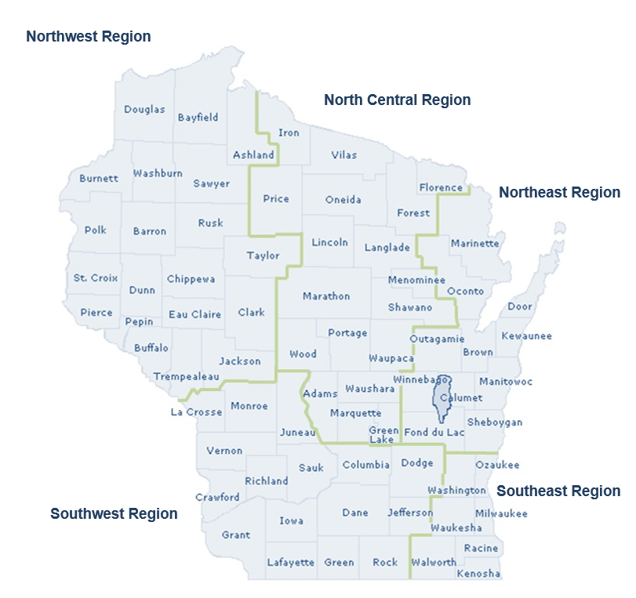
Users

Slide 24
Users
User Acceptance Authorization:
  No Acceptance
  Limited Acceptance (Non-Priority Roadways)
  Full Acceptance (Priority Roadways)

Slide 25
Users
 | User Types |  |  |  | User Regions |  | Acceptance Authority
User Roles | Maintenance | Permit | Construction | All Types | One | All | Full | Limited | No
Supervisor***
Regional Traffic Engineer (RTE)
Statewide Traffic Operations Center (STOC)
Project Manager
Project Leader
Permit Coordinator
Maintenance Coordinator
Requestor
Viewer
Public Information
***Can assign acceptance authority and administrative privileges

Slide 26
Interfaces
Request, Accept, Modify, Search, Reports

Slide 27
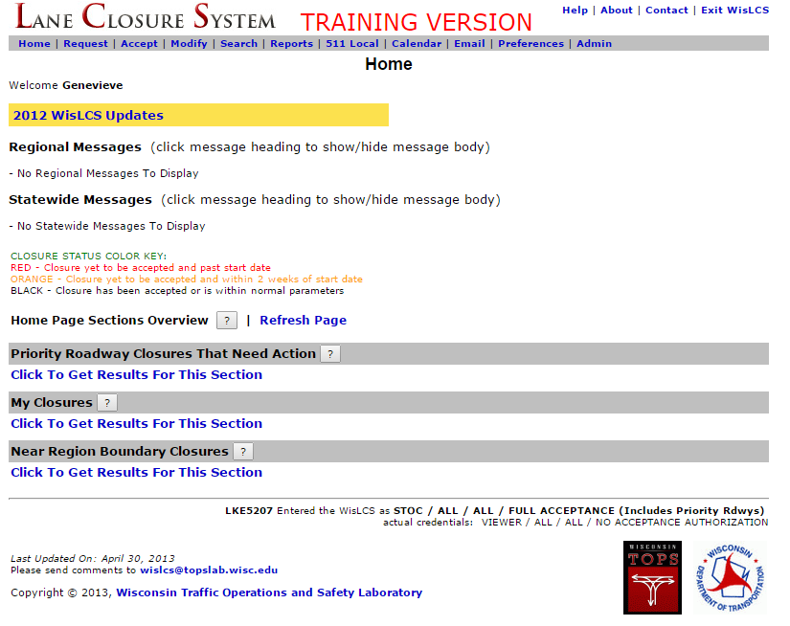
Home
Menu bar
Past Updates
Messages
Home Page Sections
Notes:
Each user will have a different home screen based on the user role.

Slide 28
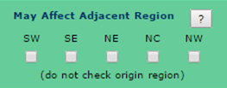
Home
Priority Roadway Closures That Need Action
  Role: Supervisor, STOC, and RTE only
  PR closures needing initial acceptance, pending date/time acceptance, and completion
My Closures
  Role: All
  Any closure where you are part of the closure history (e.g. entered, accepted, modified, etc…)
Near Region Boundary Closures
  Role: Supervisor, STOC, and RTE only (region-based)
  Closures where the region is checked in the General Section

Slide 29
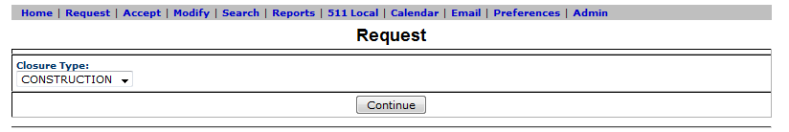
Request
Select the Request link to reach the Request Interface
Choose type of closure

Slide 30

Request
5 Types of Closures:
  Construction
  Maintenance
  Permit
  Emergency
  Special Events

Slide 31
Request
Advanced Notification:
Lane closures* | 14 calendar days
Full roadway closures | 14 calendar days
System and service ramp closures* | 14 calendar days
Full system and service ramp closures | 14 calendar days
Project start | 14 calendar days
Construction stage changes | 14 calendar days
Detours | 14 calendar days
Lane closures** | 3 business days
System and service ramp closures** | 3 business days
Modifying all closure types | 3 business days
*With height, weight, or width restrictions (available width, all lanes in one direction ≤16’)
** Without height, weight, or width restrictions (available width, all lanes in one direction >16’)

Slide 32
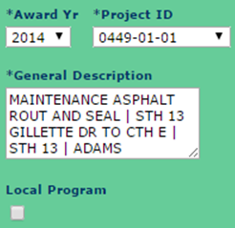
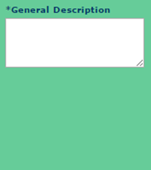
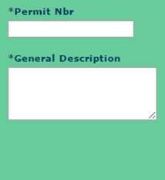
Request
Differences between request forms:
  Revisions to contact info type and required fields
  Emergency closures are automatically accepted upon entry
Construction | Maintenance Emergency Special Event | Permit

Slide 33
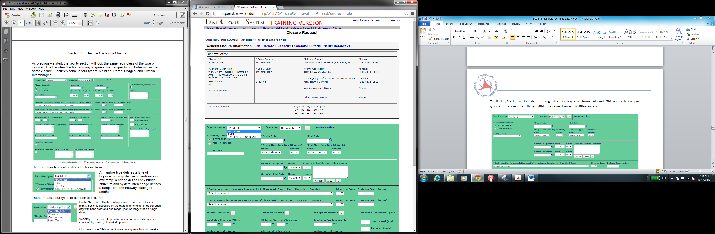
Request
Facility Type:
  3 types to choose from
Mainline | Lane(s) of a highway
Ramp | Service interchange entrance or exit ramp
System Interchange | A ramp from one freeway leading to another freeway

Slide 34
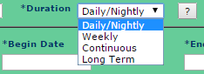
Request
Duration:
4 types of Duration to choose from
Daily/Nightly | Occurs on a daily or nightly basis as specified by the starting and ending times per each day within the start and end range
Weekly | Occurs on a weekly basis as specified by the day of week dropdowns
Continuous | 24-hour work zone lasting less than 2 weeks
Long Term | Work zone lasting longer than 2 weeks

Slide 35
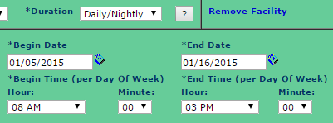
Request
Daily/Nightly example:
Cones dropped at 8:00 AM and picked up at 3:00 PM each day for 2 weeks

Slide 36
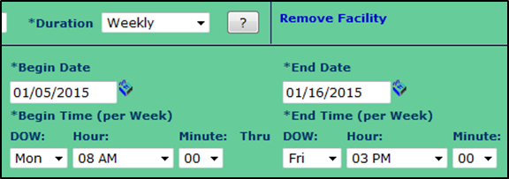
Request
Weekly example:
Cones would be dropped at 8:00 AM on Monday and picked up at 3:00 PM on Friday for 2 weeks

Slide 37
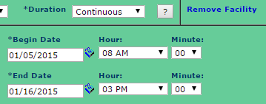
Request
Continuous example:
Cones would be dropped at 8:00 AM on Monday, January 5 and picked up at 3:00 PM on Friday, January 16.

Slide 38
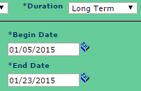
Request
Long Term example:
Cones would be dropped on January 5 and picked up on January 23.
The end date is typically modified, as the end date gets closer. Long Term closures also need to be completed in the Modify interface when the work is complete.

Slide 39
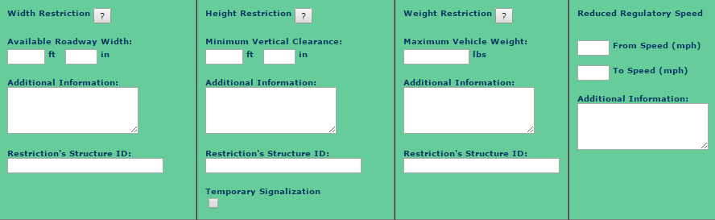
Request
Restrictions:
Width, height, and weight restrictions shared with OSOW Permitting group
Future software integration planned

Slide 40
Request
Oversize/Overweight (OSOW) Permitting Restrictions
Width | Height | Weight
Available roadway width is required for closures with a duration of 3 calendar days or longer Undivided Roadway = Width from centerline to edge of paved shoulder (up to barrels/barrier) Divided Roadway = Edge of paved shoulder to edge of paved shoulder (up to barrels/barrier) | Minimum vertical clearance through the roadway or restriction in feet (ft/in) Examples: Temporary Signals Structures Profile changes | Maximum vehicle weight allowable through the lane closure in pounds. Examples: Bridge weight posted Road weight posted

Slide 41
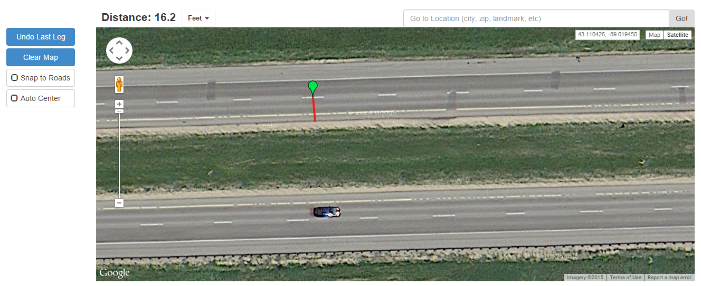
Request
Use field measurements, plan sheets, or other online tools to determine width restrictions
http://www.geodistance.com/

Slide 42
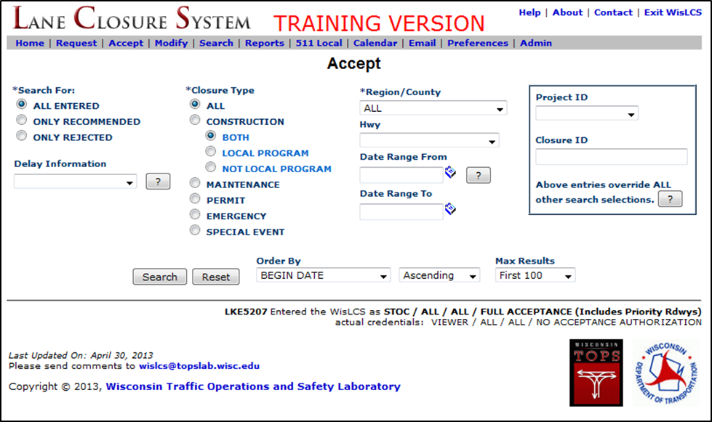
Accept
The Accept Interface is used to edit or accept closures that have been initially entered into the system but have not yet been accepted.
Only users with authorization may accept closures

Slide 43

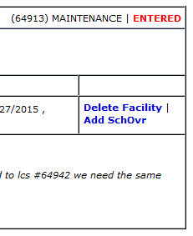
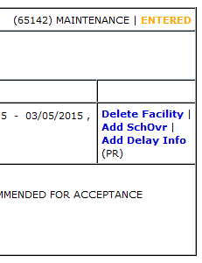
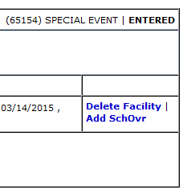
Accept
3 Closure Statuses:

Slide 44
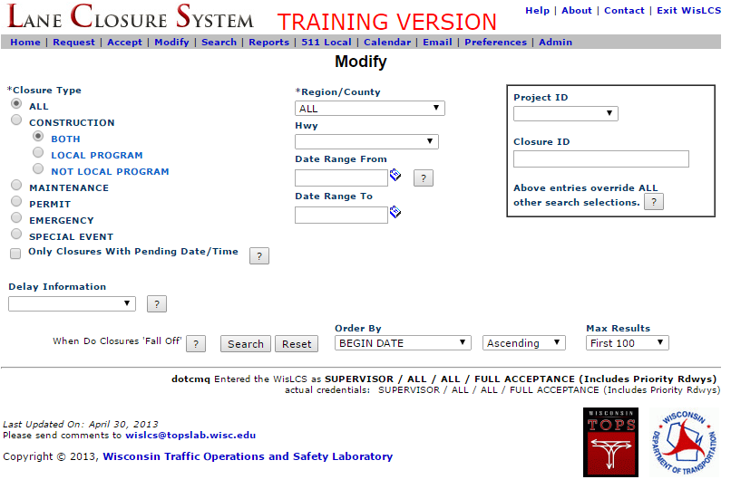
Modify
The Modify Interface is used to edit, cancel or complete closures that have been previously been accepted.
Access to edit depends on users and roles

Slide 45
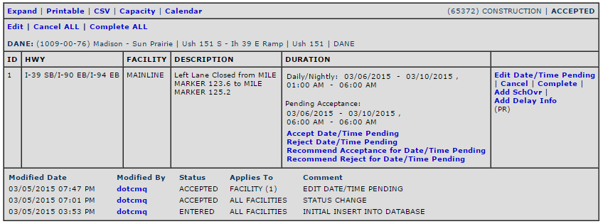
Modify
Date/Time Pending:
Date/Time edited from the Modify interface
Acceptance for Date/Time Pending occurs from the Modify interface (not the Accept interface)
Notes:
A user with acceptance authorization will be able to Accept, Reject, Recommend Accept, or Recommend Reject for the pending date/time.

Slide 46
Modify
When does a closure “Fall Off”?
Any facility that lasts 14 days or more must be manually canceled or completed
Any closure less than 14 days will “fall off” the system when its end date is greater than yesterday.
  Automatically changes from an “active” closures to an “inactive” closure

Slide 47
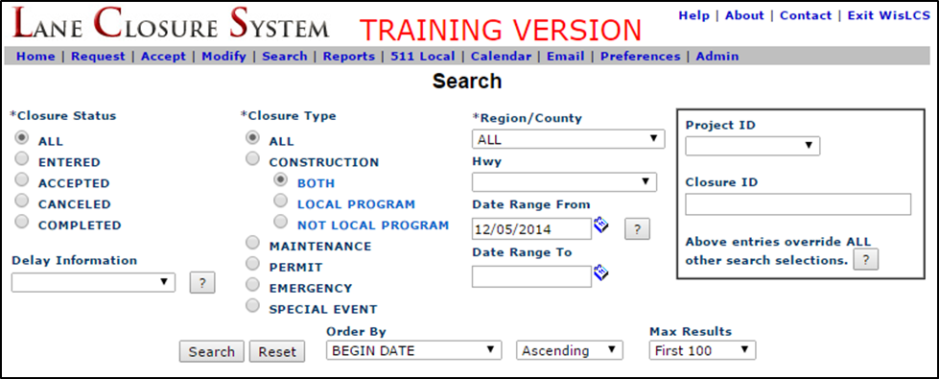
Search
The Search interface is used to access all closures within the system.

Slide 48
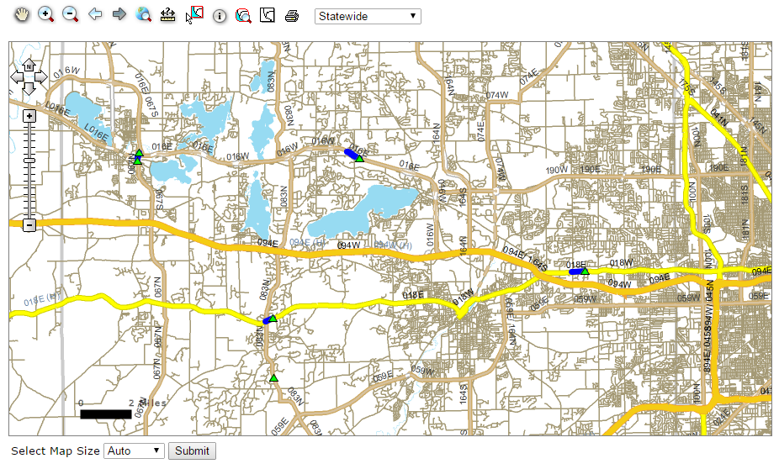
Search
LCS Map:
Map the results using the LCS Map button
Prototype functionality only (511 is an alternative option)

Slide 49
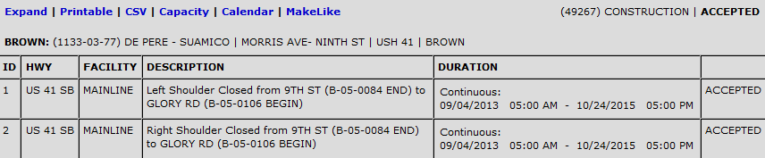
Search
Selecting the MakeLike link allows the user to add another closure with the same General Section attributes (auto-populates the General Section).
Also accessible from the Home page and from the closure request confirmation page

Slide 50
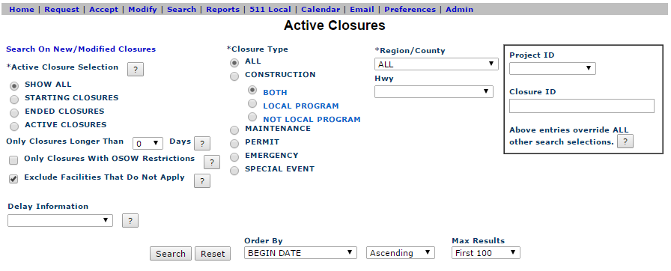
Reports
Users can use the reports interface as a way to save and print closures that are “active” within the system. Complete all required fields denoted by an asterisk (*).
NOTE: No date ranges
Notes:
Active = closure has been or is currently accepted.

Slide 51
Closure Matrix
CLOSURE STATUS | ACCEPT INTERFACE | MODIFY INTERFACE | SEARCH INTERFACE | REPORTS INTERFACE
ENTERED
ACCEPTED
CANCELED
COMPLETED
DELETED | NOTE: Deleted closures are not viewable in any interface

Slide 52
Additional LCS Resources
511 Local, Calendar, Email, Preferences and Admin Interface

Slide 53
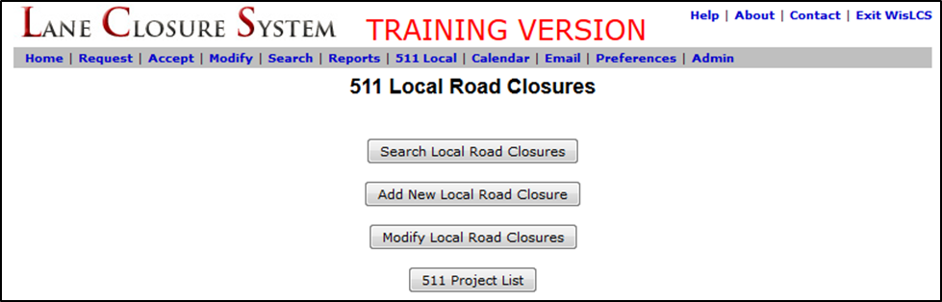
511 Local
511 Local is used to report construction closures on local streets ONLY for the 511 Construction Projects website (http://projects.511wi.gov/).
Accessibility depends on user privileges
There is no acceptance process with this interface; closures will automatically be accepted.
Notes:
This information is used primarily for public information.

Slide 54
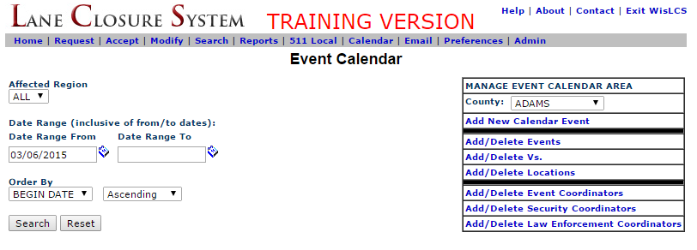
Calendar
Used for viewing special events (not event closures) that have been entered into the system.
Provides a repository of special events throughout the state to inform personnel requesting or accepting closures of potential events.

Slide 55
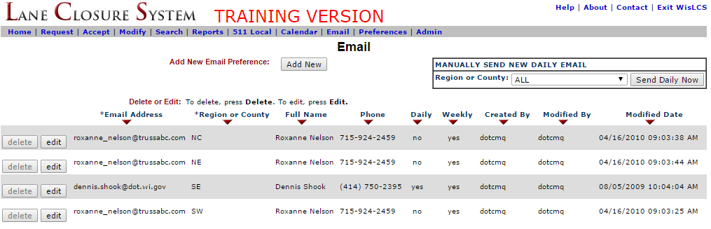
E-mail Interface
Users can sign up to receive daily (3 PM Daily) or weekly (3 PM Friday) e-mail reports by region or county.
Manage a user’s own e-mail reports and/or other (external) e-mail addresses to receive reports.

Slide 56
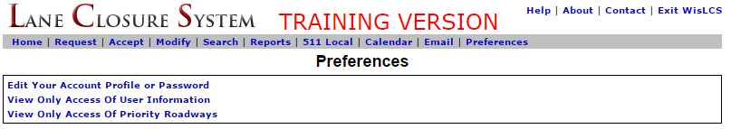
Preferences Interface
Preferences allows users to:
Edit Your Account Profile or Password
View Only Access of User Information
View Only Access of Priority Roadways

Slide 57
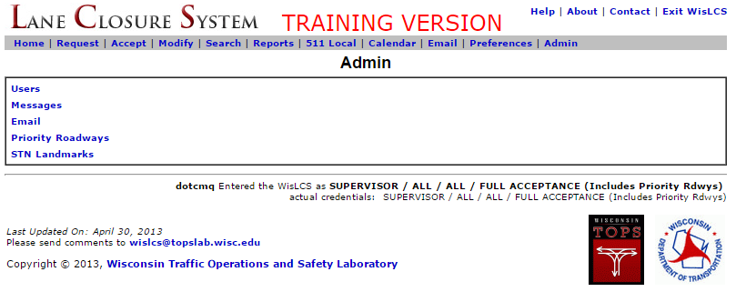
Admin
The Admin interface has five links and is only available to those roles that have administrative authorization.

Slide 58
Support Tools
Documentation, Contacts, Help Tools

Slide 59
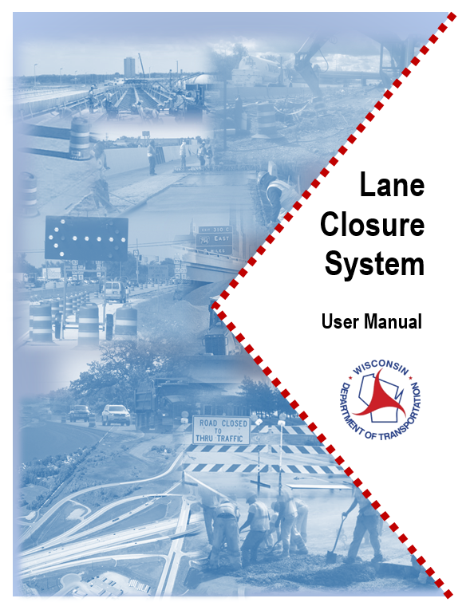
Documentation
http://transportal.cee.wisc.edu/closures/manual.html
User Manual
Quick Reference Guides
PowerPoint Presentations
FAQs

Slide 60
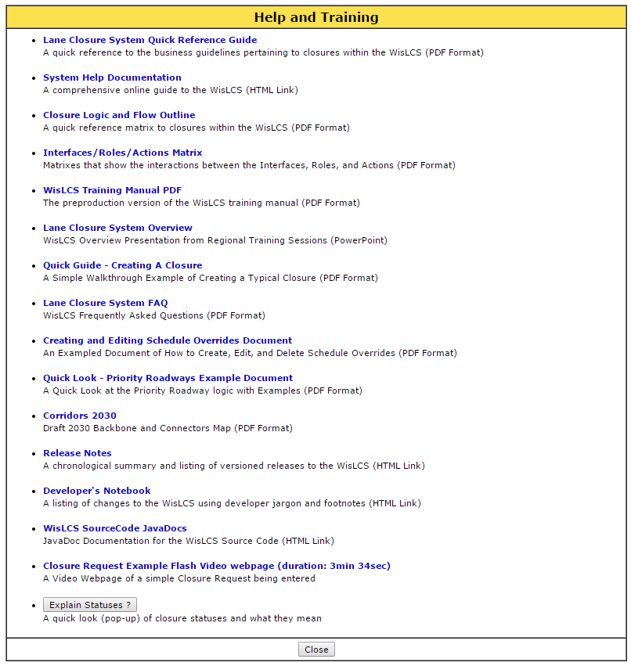
Help
Additional Help information and documentation is available within the LCS System

Slide 61
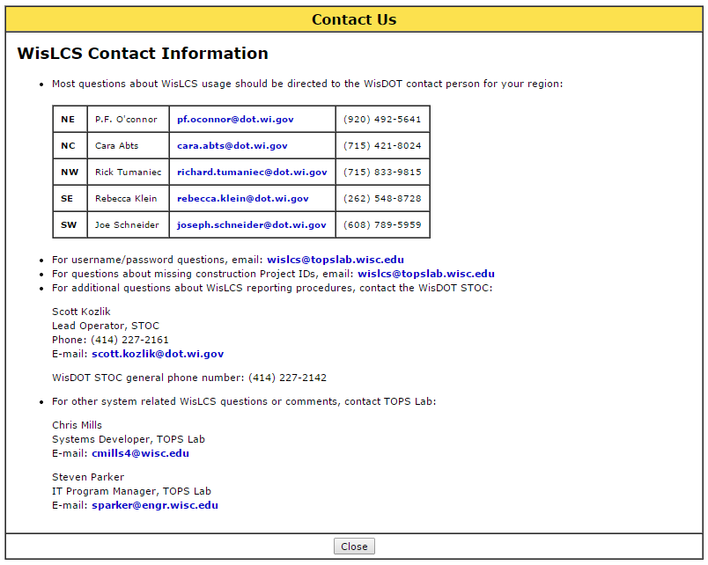
Contacts

Slide 62
Notifications
Personalize e-mail notifications are sent to users:
Pending/Past Start-Date
  Sent To: Primary/Secondary Contacts
Pending Date/Time
  Sent To: Requestor/Acceptor
Long-Term Closure
  Sent To: Primary/Secondary Contacts
Friday Long-Term Closure
  Sent To: RTEs
Notes:
The LCS will send personalized, automated e-mails to users to notify the users of certain conditions. A summary of those e-mail notifications is below.
Pending/Past Start-Date Notice: E-mail sent to the primary and secondary contacts listed in the general section of the closure when the closure is less than two days or past the schedule start date and has not been accepted.
Pending Date/Time E-mail: E-mail sent to the requestor and acceptor of the closure once a pending date/time has been submitted.
Long-Term Closure E-mail: E-mail sent to the primary and secondary contacts listed in the general section of the closure when the long-term closure (greater than 14 days) is within two weeks of the end date and is required to be manually completed.
Friday Long-Term Closure E-mail: E-mail sent to the five regional work zone contacts on a weekly basis to flag closures that are past their end date.

Slide 63
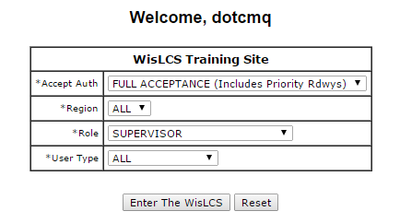
Training Site
The Training Site is like a sandbox to play with closures. Others may modify previously submitted closures.
May enter the system with different authorization, regions, roles, and types.
http://transportal.cee.wisc.edu/training/WisLCS/Logon.do

Slide 64
Closure Walk-Through

Slide 65
Activity

